Slide 1


Python Machine Learning
Žydrūnė Kelpšaitė
Data Analyst

Slide 2
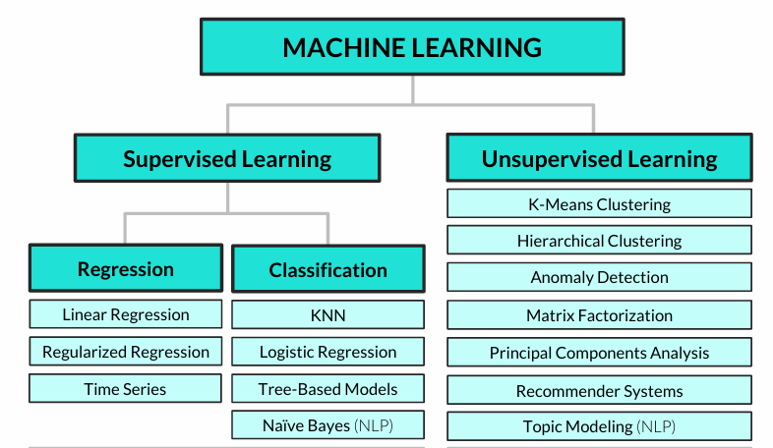
Common machine learning algorithms

Slide 3
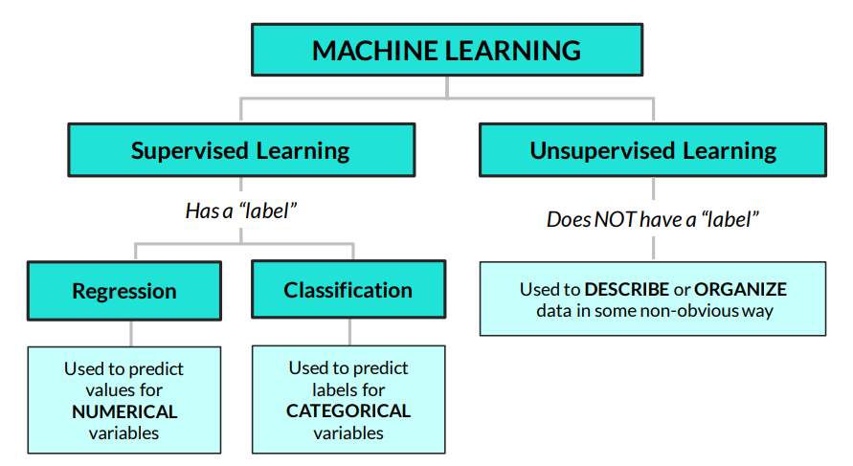
UNSUPERVISED LEARNING 101
Unsupervised learning is about finding insights & patterns hidden in the data
• Unlike regression or classification, we don’t care about splitting our data into train / test sets and making predictions, we just care about understanding the relationships in our data

Slide 4
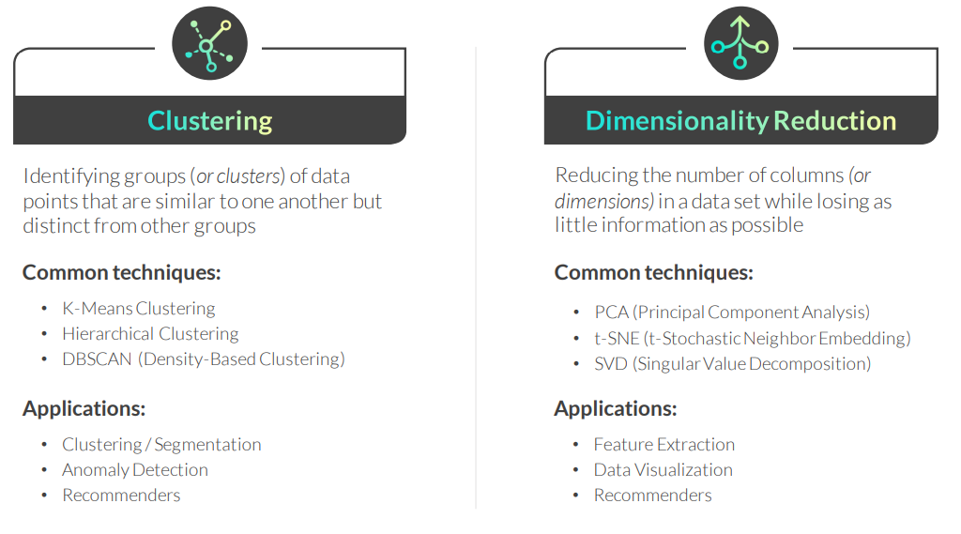
UNSUPERVISED LEARNING TECHNIQUES
There are two popular categories of unsupervised learning techniques:

Slide 5
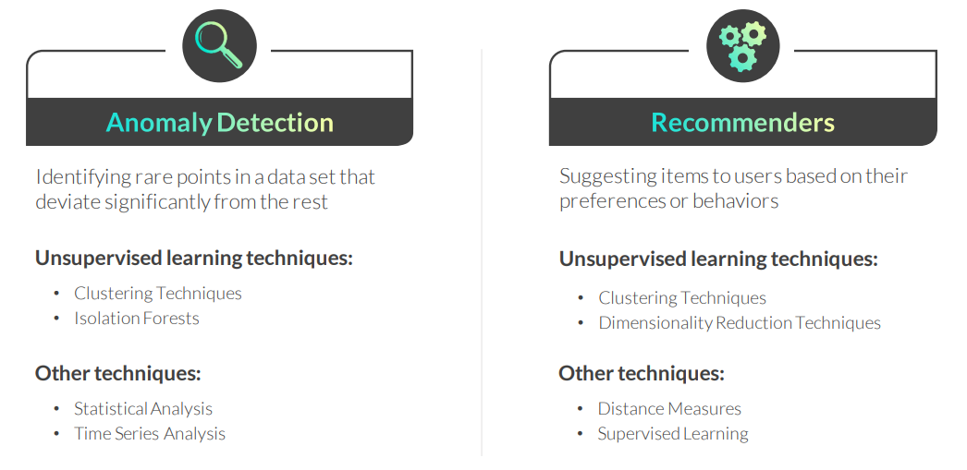
UNSUPERVISED LEARNING APPLICATIONS
These are two common applications of unsupervised learning techniques:

Slide 6
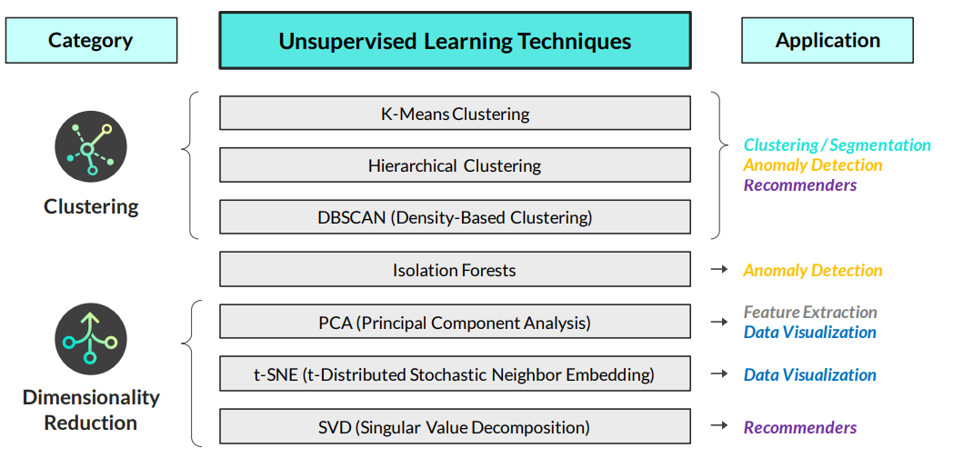
Unsupervised learning techniques & applications

Slide 7
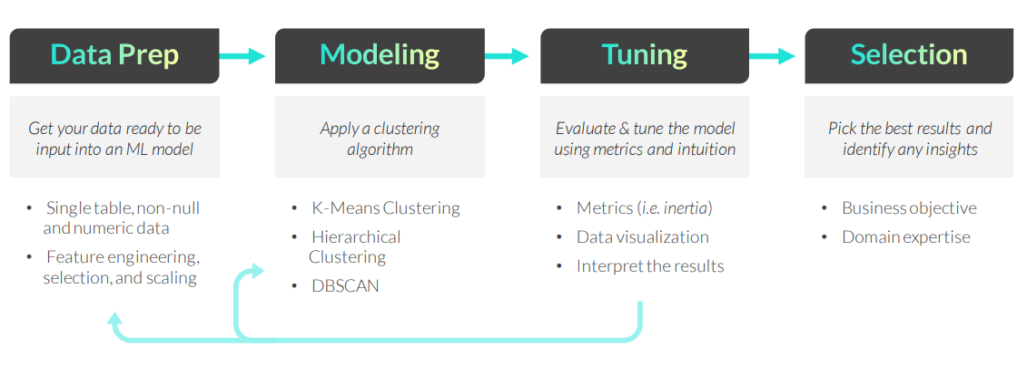
CLUSTERING WORKFLOW
The general clustering workflow consists of the following steps:
Remember, there’s no “right” answer or single optimization metric when it comes to clustering; the best outputs are the ones which help you answer the question at hand and make practical, data-driven business decisions

Slide 8
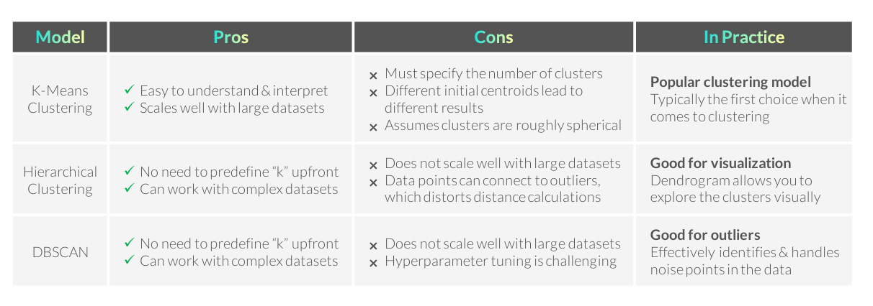
CLUSTERING ALGORITHMS RECAP

Slide 9
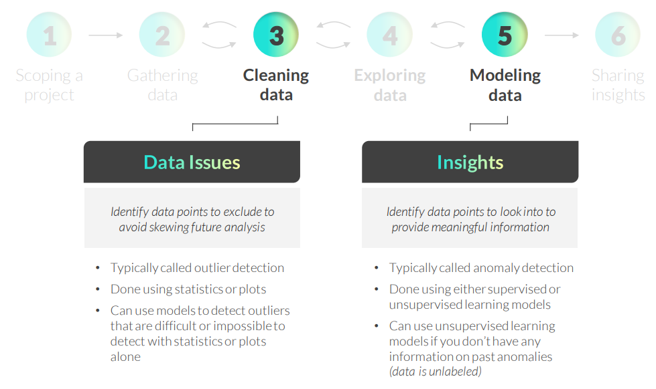
ANOMALY DETECTION IN THE DS WORKFLOW

Slide 10
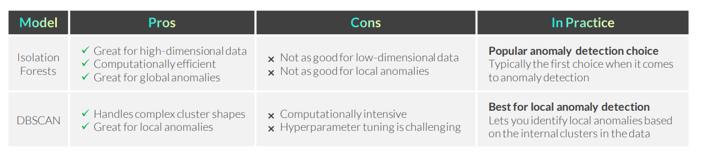
RECAP: ANOMALY DETECTION

Slide 11
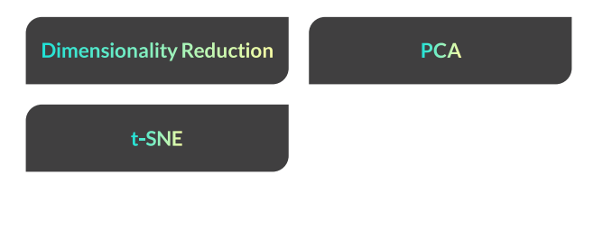
DIMENSIONALITY REDUCTION
Notes:
PCA – Principal Component Analysis (Pagrindinių komponentų analizė) Linijinis dimensijų mažinimo metodas, kuris transformuoja pradinius kintamuosius į naujus, tarpusavyje nekoreliuotus komponentus. Šie komponentai išlaiko didžiausią duomenų variaciją ir leidžia sumažinti požymių skaičių neprarandant esminės informacijos. Dažnai naudojamas vizualizacijai ir feature engineering.
t-SNE – t-Distributed Stochastic Neighbor Embedding Nelinijinis dimensijų mažinimo metodas, skirtas aukštų dimensijų duomenų vizualizacijai. Jis išlaiko lokalią struktūrą – panašūs taškai lieka arti vienas kito 2D ar 3D erdvėje. Dažniausiai naudojamas klasterių ir struktūrų vizualiniam atskleidimui.
SVD – Singular Value Decomposition (Singuliarinių reikšmių dekompozicija) Matricos faktorizacijos metodas, kuris išskaido duomenų matricą į tris komponentes ir leidžia sumažinti jos rangą. Naudojamas dimensijų mažinimui, duomenų suspaudimui ir rekomendacinėse sistemose, kur reikia išskirti pagrindinius vartotojų–produktų sąveikos veiksnius.

Slide 12
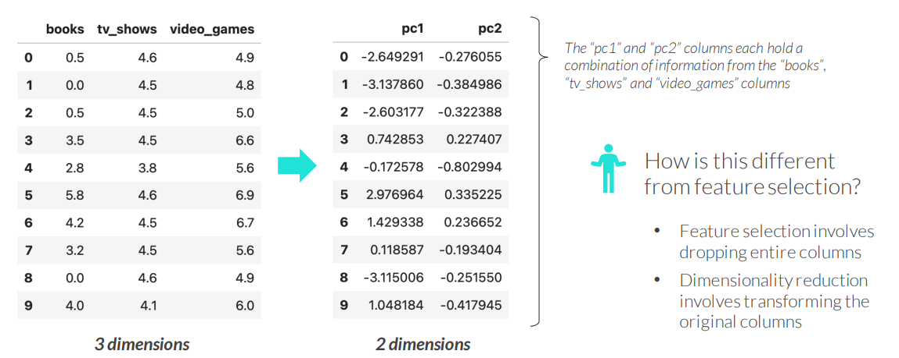
DIMENSIONALITY REDUCTION BASICS
Dimensionality reduction involves reducing the number of columns (dimensions) in a data set while losing as little information as possible

Slide 13
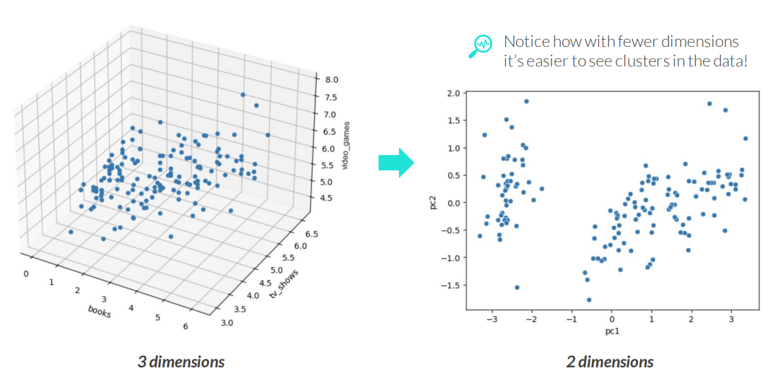
DIMENSIONALITY REDUCTION BASICS
Dimensionality reduction involves reducing the number of columns (dimensions) in a data set while losing as little information as possible

Slide 14
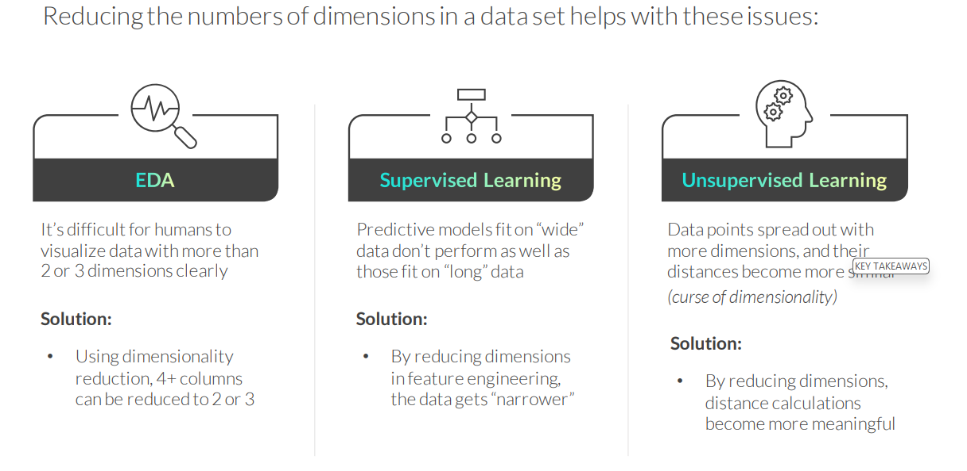
WHY REDUCE DIMENSIONS?

Slide 15
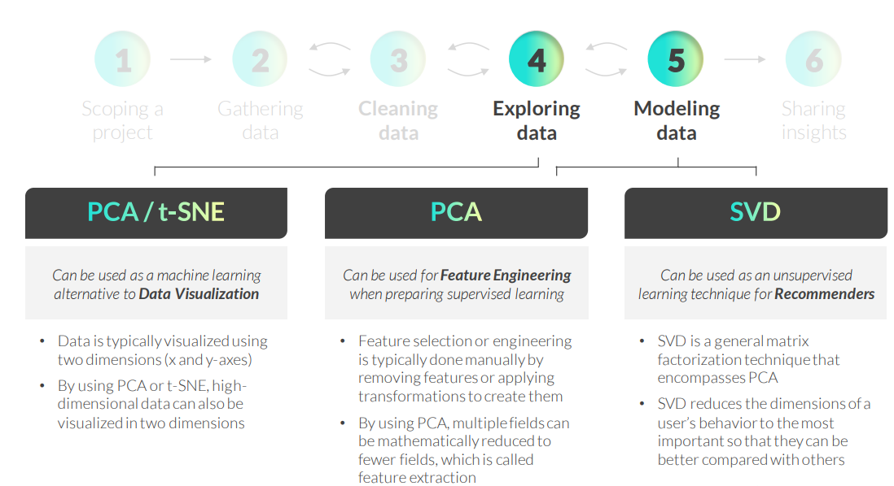
DIMENSIONALITY REDUCTION IN DS WORKFLOW
Notes:
PCA – Principal Component Analysis (Pagrindinių komponentų analizė) Linijinis dimensijų mažinimo metodas, kuris transformuoja pradinius kintamuosius į naujus, tarpusavyje nekoreliuotus komponentus. Šie komponentai išlaiko didžiausią duomenų variaciją ir leidžia sumažinti požymių skaičių neprarandant esminės informacijos. Dažnai naudojamas vizualizacijai ir feature engineering.
t-SNE – t-Distributed Stochastic Neighbor Embedding Nelinijinis dimensijų mažinimo metodas, skirtas aukštų dimensijų duomenų vizualizacijai. Jis išlaiko lokalią struktūrą – panašūs taškai lieka arti vienas kito 2D ar 3D erdvėje. Dažniausiai naudojamas klasterių ir struktūrų vizualiniam atskleidimui.
SVD – Singular Value Decomposition (Singuliarinių reikšmių dekompozicija) Matricos faktorizacijos metodas, kuris išskaido duomenų matricą į tris komponentes ir leidžia sumažinti jos rangą. Naudojamas dimensijų mažinimui, duomenų suspaudimui ir rekomendacinėse sistemose, kur reikia išskirti pagrindinius vartotojų–produktų sąveikos veiksnius.

Slide 16
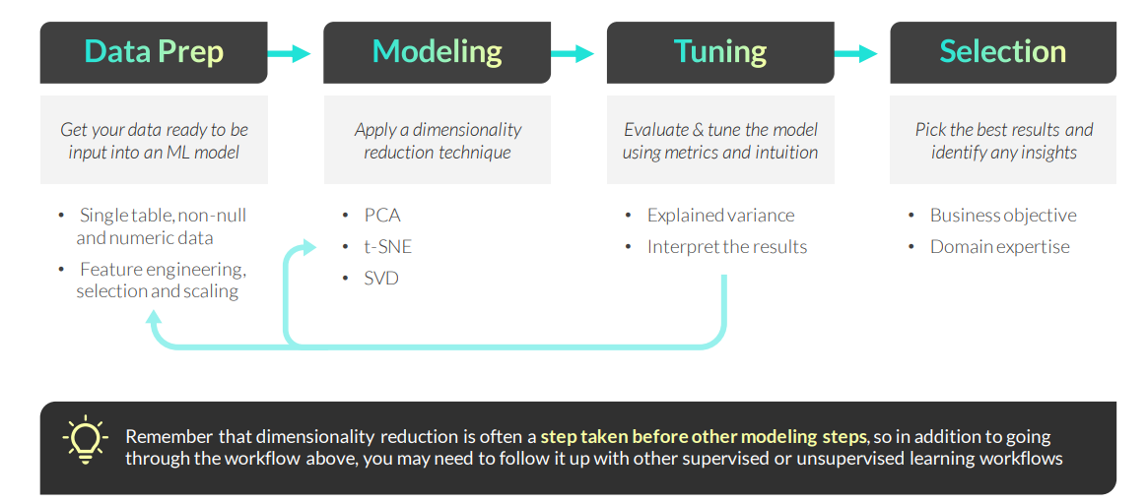
DIMENSIONALITY REDUCTION WORKFLOW
The general dimensionality reduction workflow consists of the following steps:

Slide 17
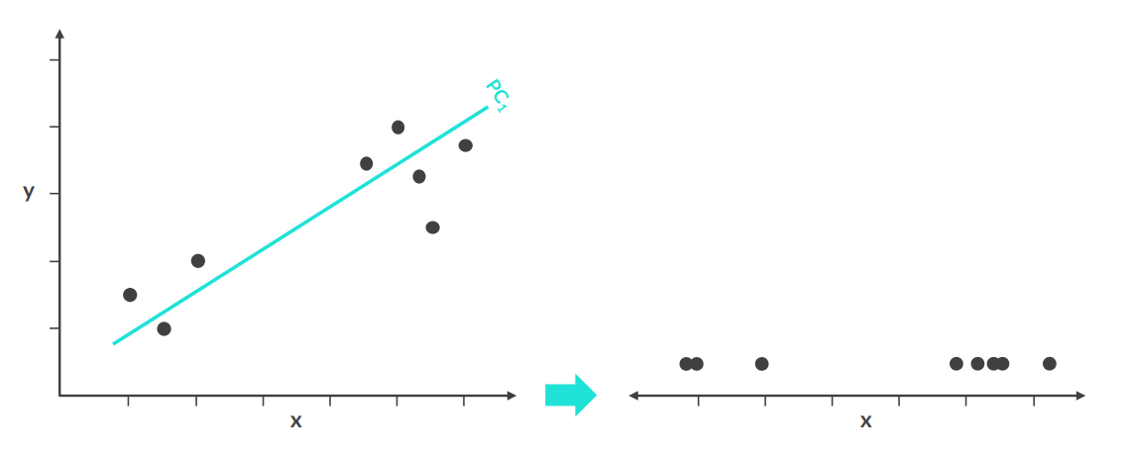
PRINCIPAL COMPONENT ANALYSIS
Principal Component Analysis (PCA) is a dimensionality reduction technique that finds linear combinations of features that explain the most variation in the data

Slide 18
PRINCIPAL COMPONENT ANALYSIS
Principal Component Analysis (PCA) is a dimensionality reduction technique that finds linear combinations of features that explain the most variation in the data
Here’s how it works:
1. Create a scatter plot and find the center of the data
2. Trace a line through the center that captures the most spread, or variation, in the data – this is the first principal component (PC1)
3. Create another line perpendicular to the first one that captures the most spread, or variation, in the data– this is the second principal component (PC2)
4. Repeat Step 3 until you have as many principal components as original columns
5. To reduce dimensions, keep a subset of principal components (i.e. PC1 only)
Example use cases:
• Visualizing clusters in fewer dimensions to spot-check clustering/segmentation results
• Improving a model’s predictive power by reducing redundant or unnecessary dimensions

Slide 19
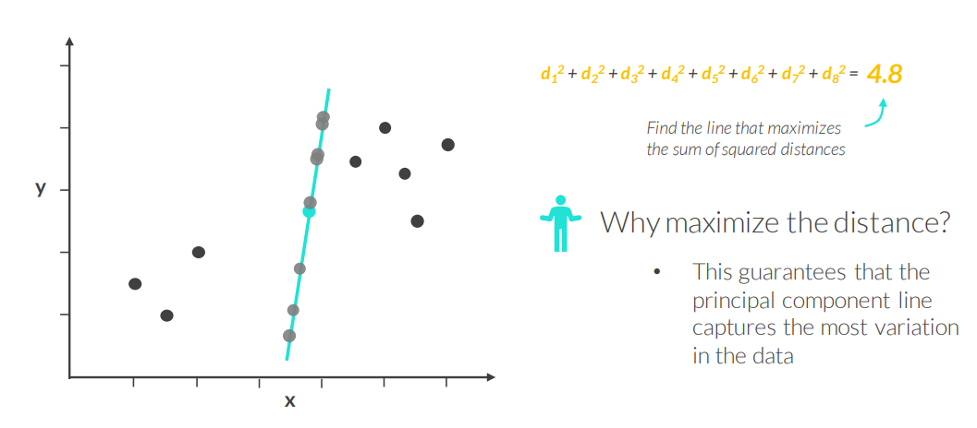
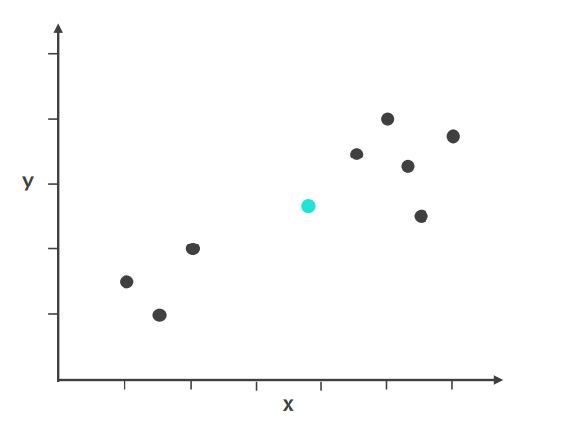
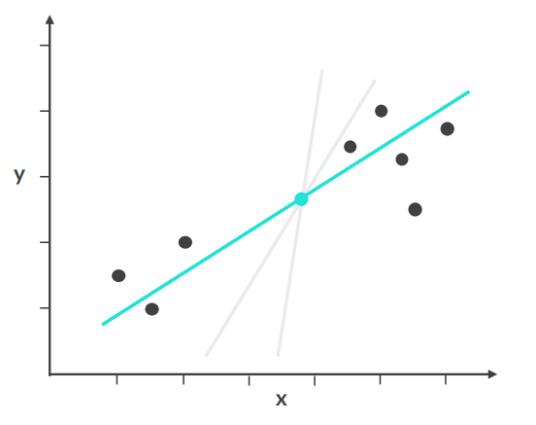
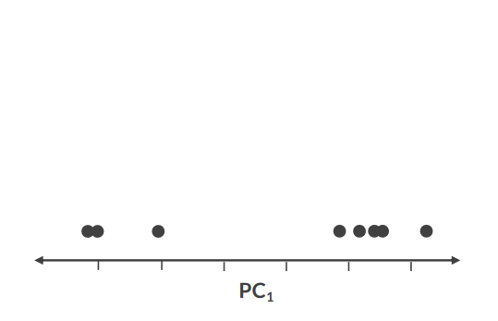
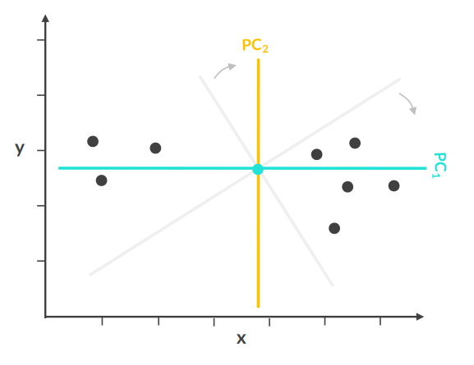
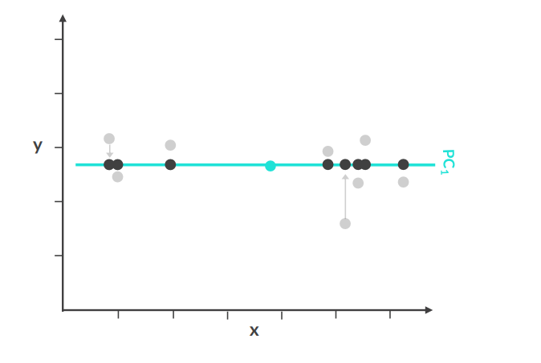
PRINCIPAL COMPONENT ANALYSIS
Notes:
PCA yra metodas, kuris perorientuoja duomenis taip, kad rastų kryptį, kurioje yra daugiausia variacijos. Ta kryptis vadinama pirmuoju pagrindiniu komponentu (PC1). Kiti komponentai yra statmeni pirmajam ir paaiškina likusią variaciją.
Dimensijų mažinimas reiškia, kad pasiliekame tik svarbiausius komponentus (pvz., PC1 ir PC2) ir atmetame mažiau informatyvias kryptis, taip išlaikydami didžiąją dalį informacijos, bet su mažiau kintamųjų.

Slide 20
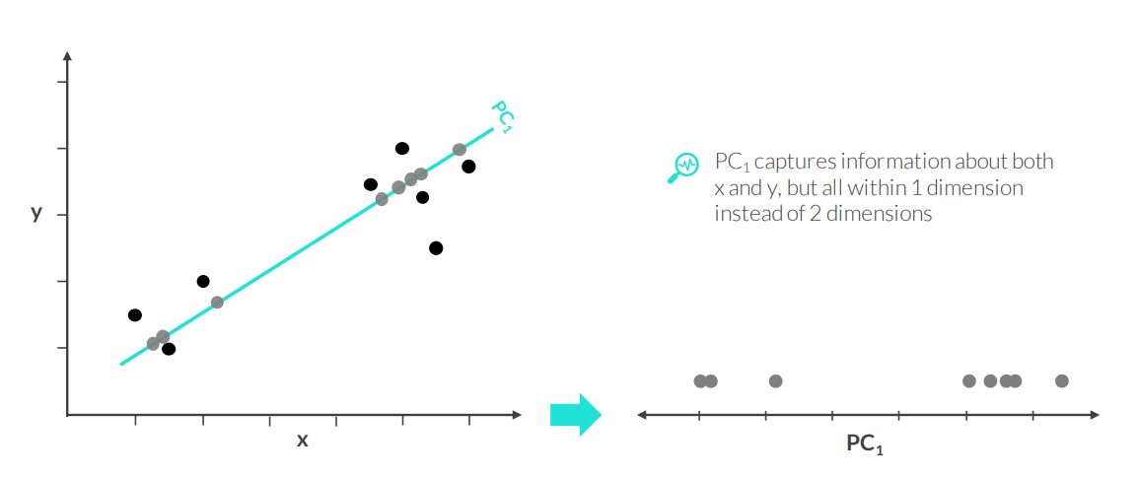
PRINCIPAL COMPONENT ANALYSIS
By using principal component analysis, we’ve reduced the number of columns (dimensions) in the data while losing as little information as possible

Slide 21
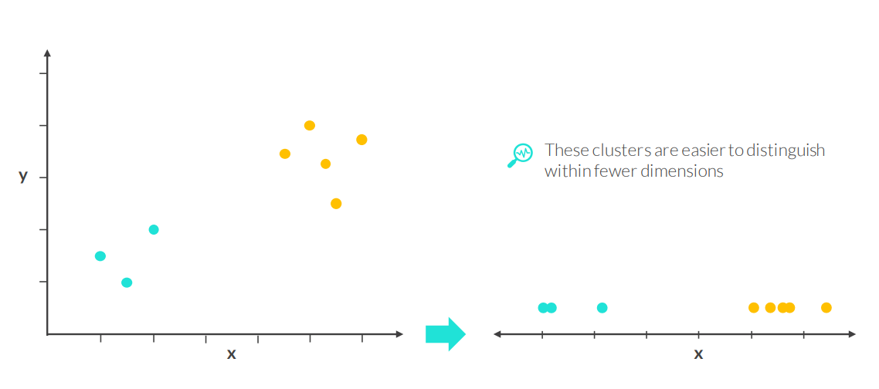
PRINCIPAL COMPONENT ANALYSIS
By using principal component analysis, we’ve reduced the number of columns (dimensions) in the data while losing as little information as possible

Slide 22
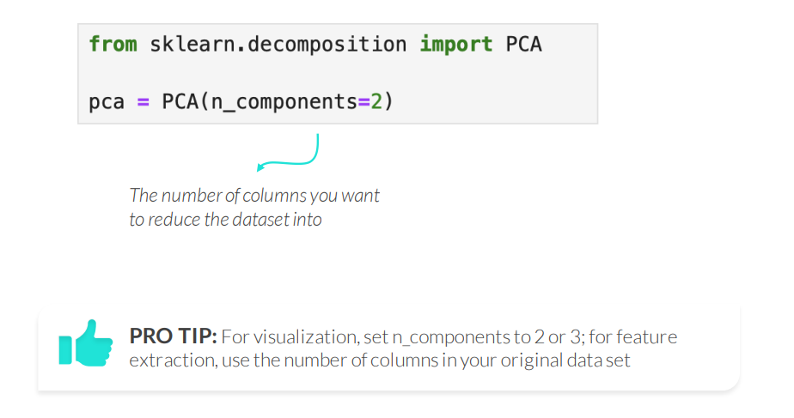
PRINCIPAL COMPONENT ANALYSIS IN PYTHON
Use sklearn’s PCA() to apply the Principal Component Analysis algorithm

Slide 23
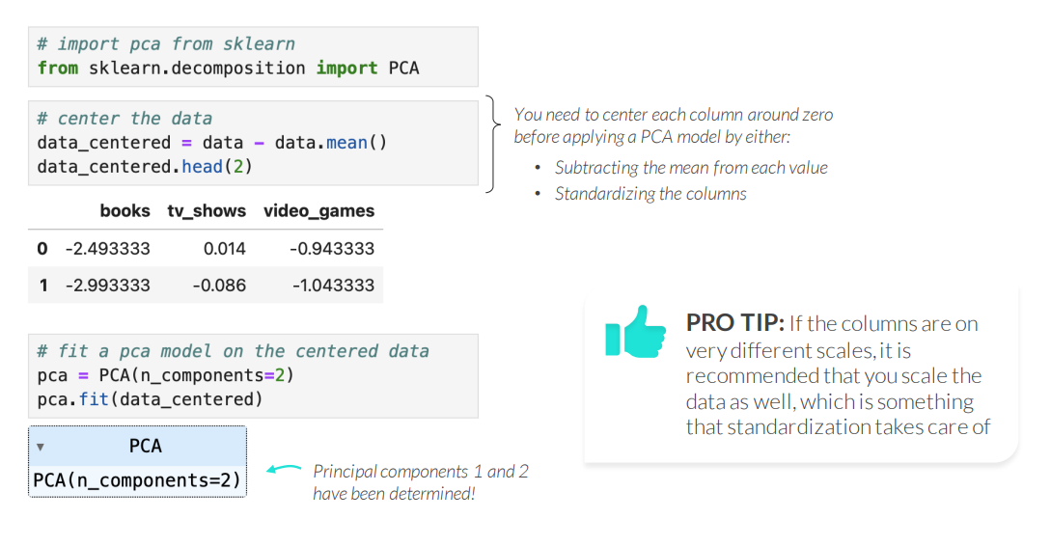
PRINCIPAL COMPONENT ANALYSIS IN PYTHON
Use sklearn’s PCA() to apply the Principal Component Analysis algorithm
Notes:
StandardScaler()

Slide 24
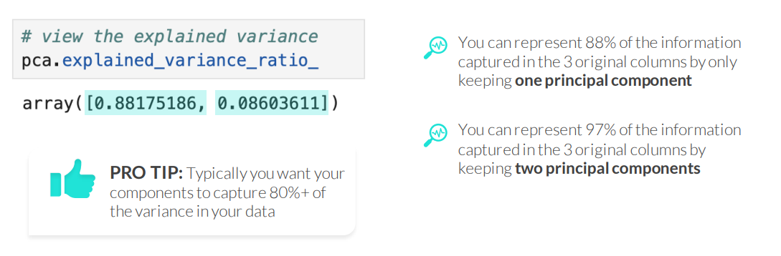
EXPLAINED VARIANCE RATIO
The explained variance ratio shows how much of the variation from the data is captured by each principal component
• The first component will always capture the most variance, and then it decreases from there
• The sum of the explained variance ratios across all components will be equal to 1

Slide 25
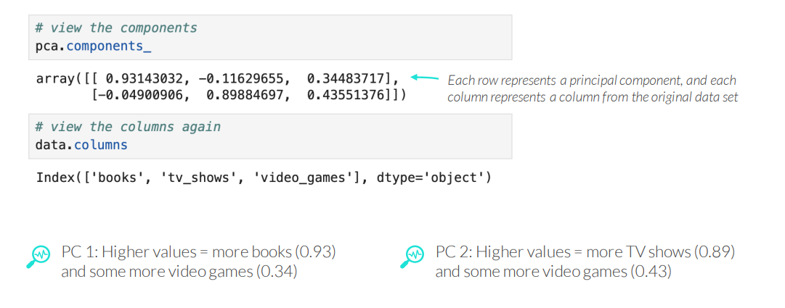
INTERPRETING PCA
The .components_ attribute lets you interpret the principal components

Slide 26
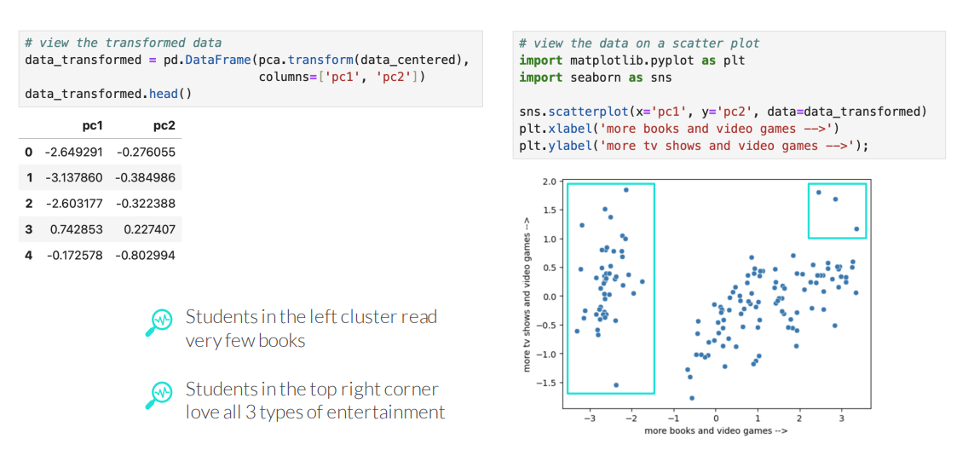
VISUALIZING PCA
Use the .transform() method to transform the original observations into the new dimensional space, which you can then visualize in a scatter plot

Slide 27
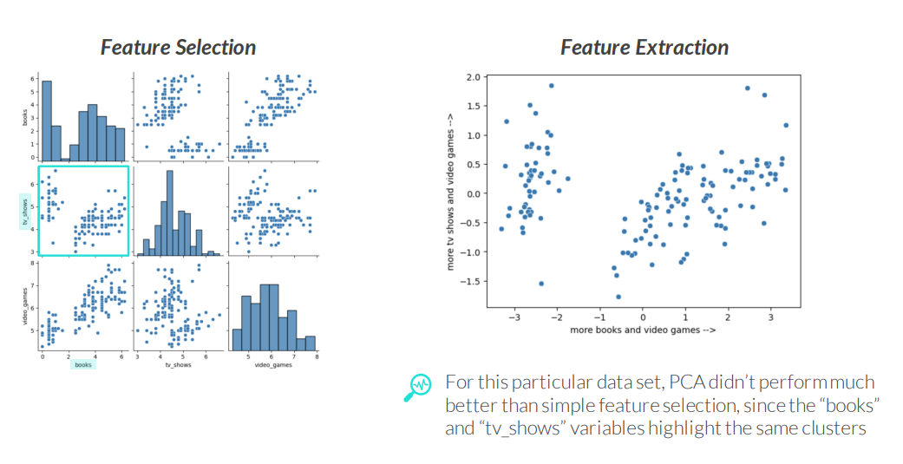
FEATURE SELECTION VS FEATURE EXTRACTION
feature selection and feature extraction are both ways to reduce the number of dimensions or columns in a table

Slide 28
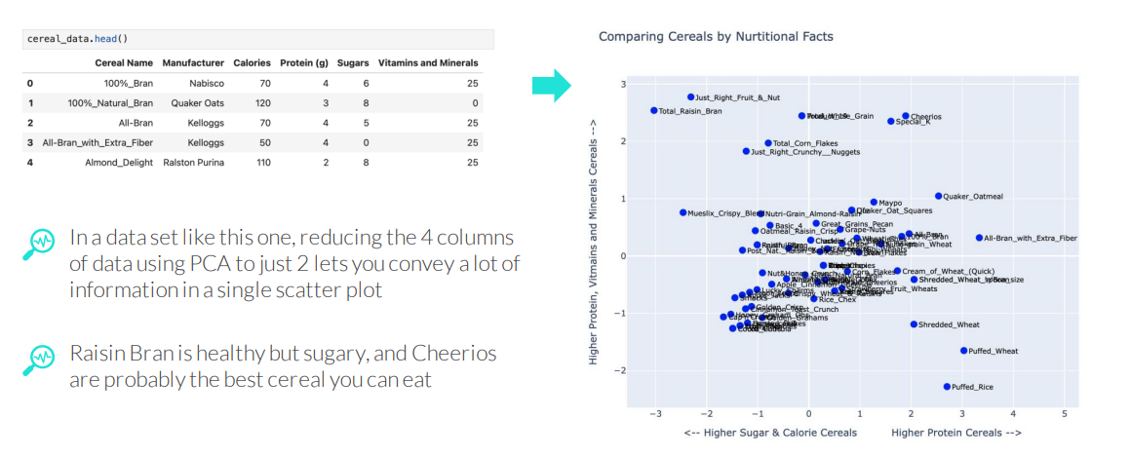
FEATURE SELECTION VS FEATURE EXTRACTION
feature selection and feature extraction are both ways to reduce the number of dimensions or columns in a table

Slide 29
PCA NEXT STEPS
Once you have fit and interpreted a PCA model, the next steps are:
Data Visualization
• If you’re able to distinguish data points visually, you’re all set!
• If it’s difficult to visually distinguish data points:
• You can vary the inputs, modify the number of dimensions, etc.
• You can try other dimensionality reduction techniques – t-SNE.
Modeling
• Once you’ve identified the principal components, they can used be inputs into a machine learning model
• You’ll need to apply the same PCA transformations to the test data
While PCA is a good technique for reducing dimensions to potentially increase predictive model performance, one of the main downsides is that the transformed features are difficult to interpret

Slide 30
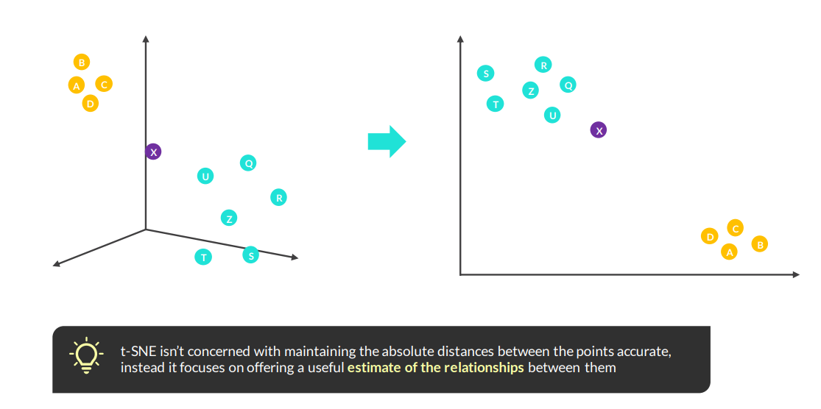
T-SNE
t-Distributed Stochastic Neighbor Embedding (t-SNE) is a non-linear dimensionality reduction technique that emphasizes relationships between points

Slide 31
T-SNE
t-Distributed Stochastic Neighbor Embedding (t-SNE) is a non-linear dimensionality reduction technique that emphasizes relationships between points
Here’s how it works:
Calculate the distance between points in a high-dimensional space
2. Use the distances to calculate the affinity score (0-1) for each point with the rest; in other words, how likely it is that they are “neighbors” (high affinity score = high probability of being neighbors)
3. Calculate the average affinity score for each pair of points 4. Randomly place the data points in a low dimensional space – 2D
5. Use the affinity scores between pairs to attract (high affinity) or repulse (low affinity) the points until they have “stabilized” into their final position
Example use cases:
• Visualizing clusters in limited dimensions to spot-check cluster/segmentation outputs

Slide 32
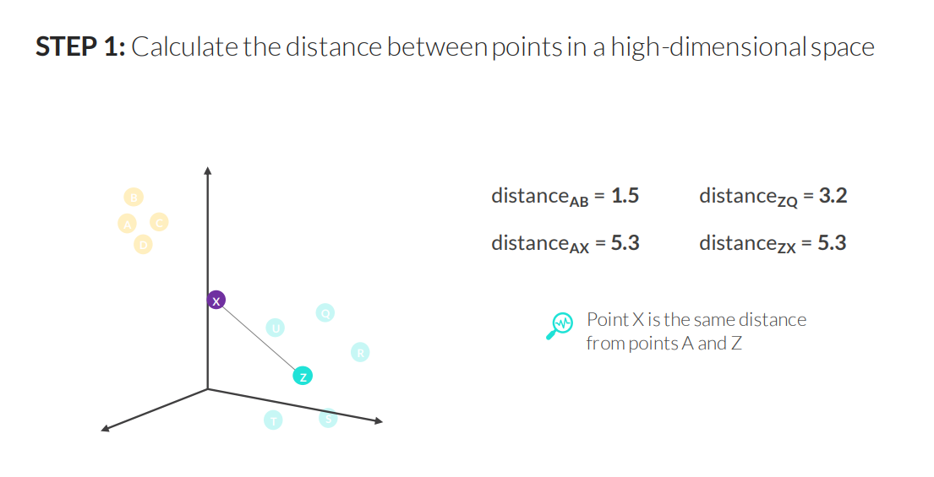
T-SNE

Slide 33
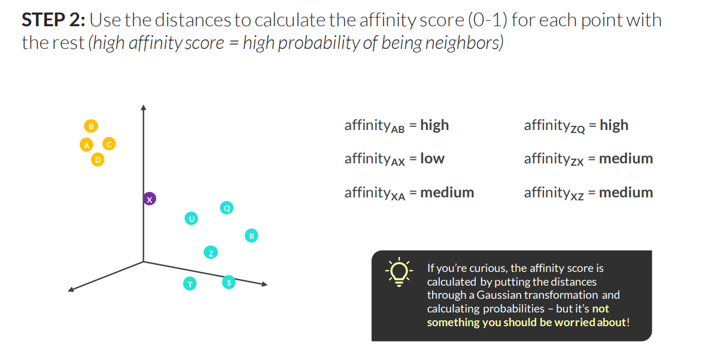
T-SNE

Slide 34
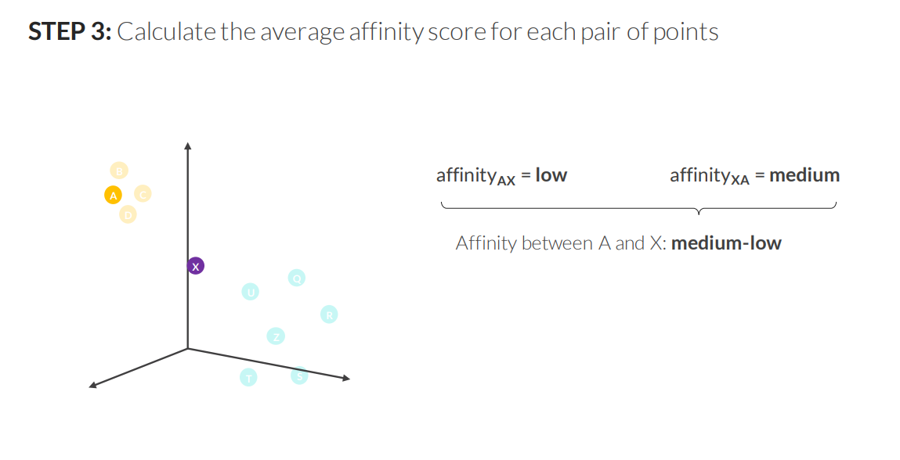
T-SNE

Slide 35
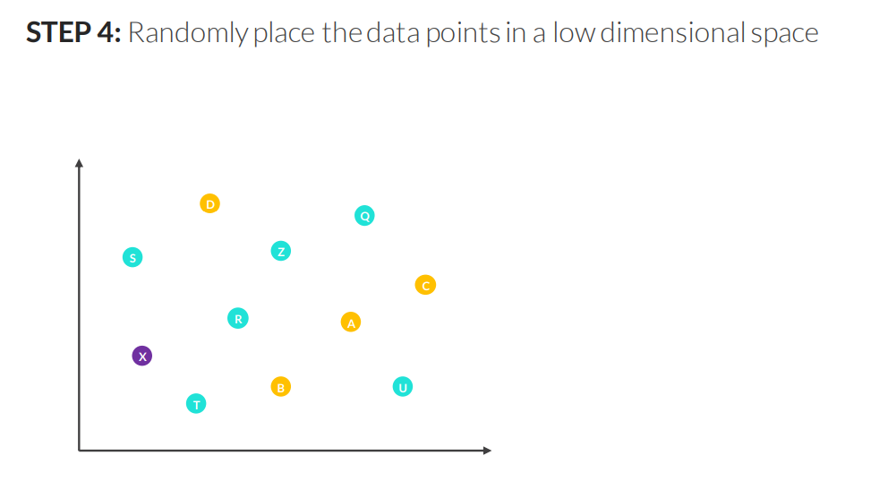
T-SNE

Slide 36
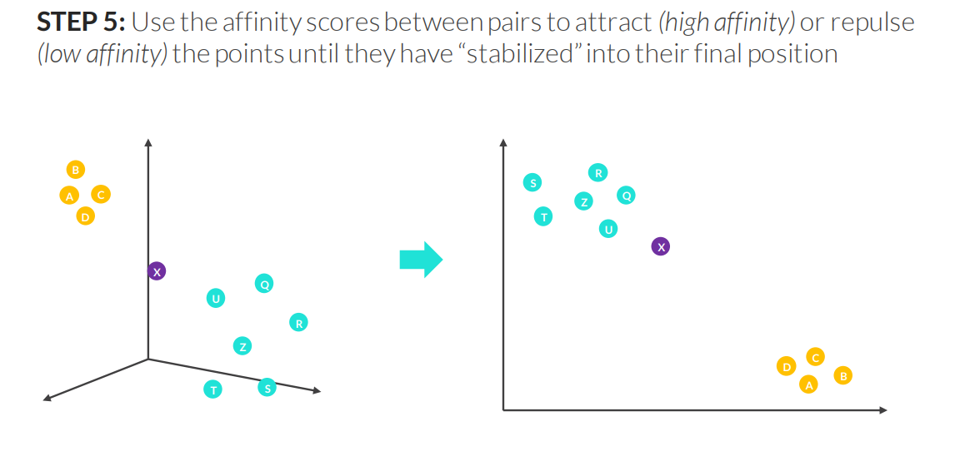
T-SNE

Slide 37
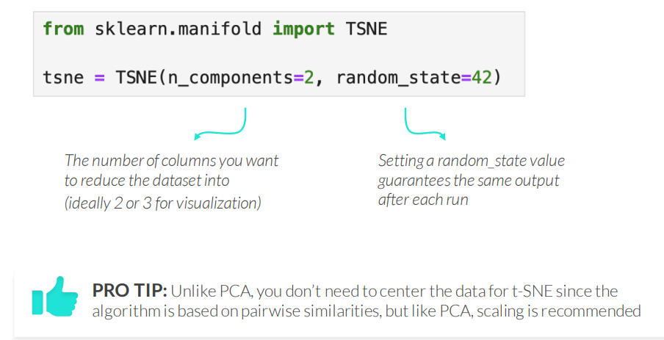
T-SNE IN PYTHON
Use sklearn’s TSNE() to apply the t-SNE algorithm in Python
Notes:
t-SNE – t-Distributed Stochastic Neighbor Embedding Nelinijinis dimensijų mažinimo metodas, skirtas aukštų dimensijų duomenų vizualizacijai. Jis išlaiko lokalią struktūrą – panašūs taškai lieka arti vienas kito 2D ar 3D erdvėje. Dažniausiai naudojamas klasterių ir struktūrų vizualiniam atskleidimui.

Slide 38
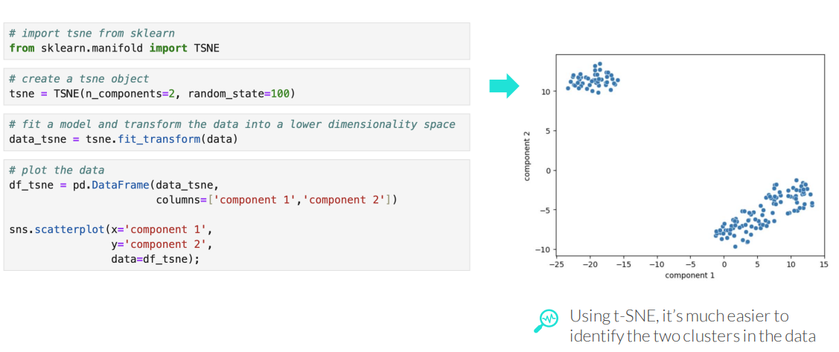
T-SNE IN PYTHON
Use sklearn’s TSNE() to apply the t-SNE algorithm in Python

Slide 39
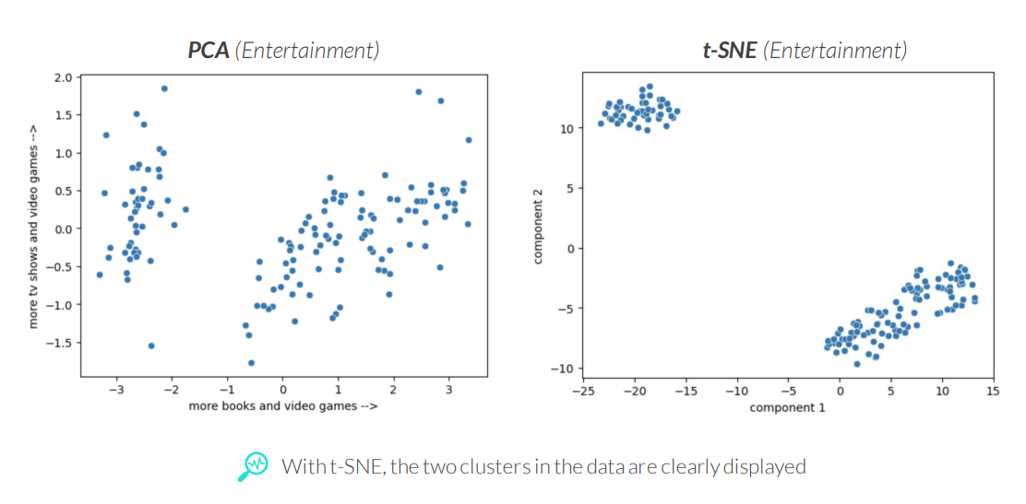
PCA VS T-SNE
PCA visualizations are more accurate and interpretable, while t-SNE visualizations are better at visually separating groups of data into clusters

Slide 40
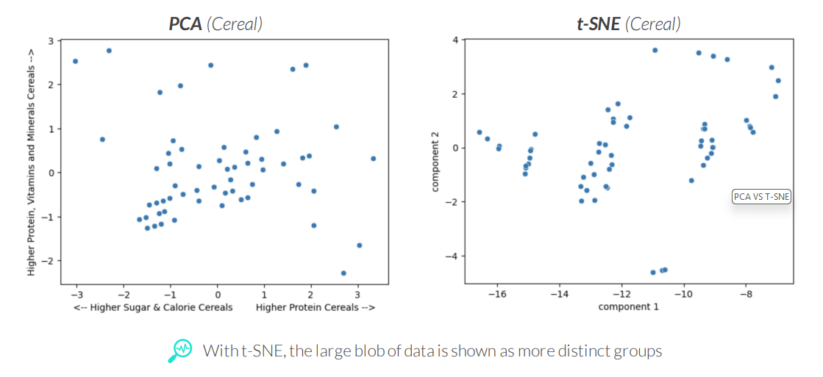
PCA VS T-SNE
PCA visualizations are more accurate and interpretable, while t-SNE visualizations are better at visually separating groups of data into clusters

Slide 41
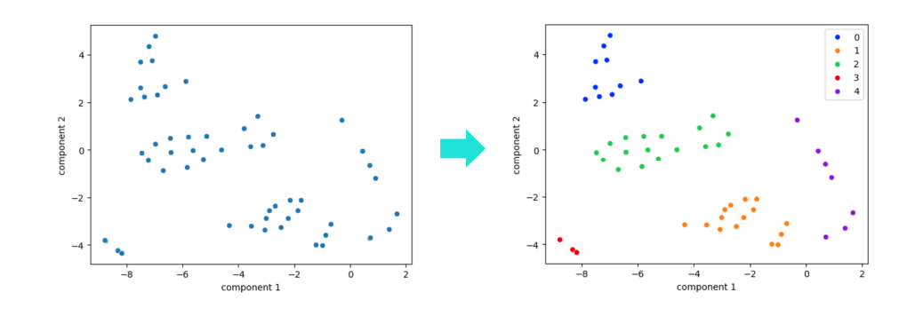
DIMENSIONALITY REDUCTION & CLUSTERING
Visualizations created from dimensionality reduction techniques like PCA and t-SNE can help identify clusters while fitting clustering algorithms

Slide 42
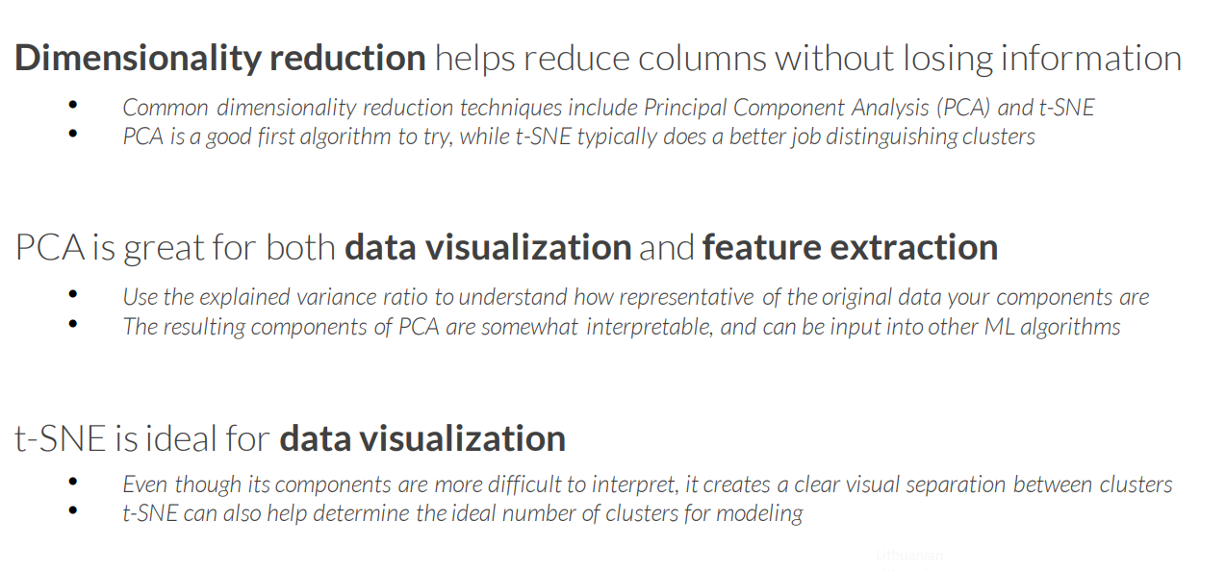
KEY TAKEAWAYS

